Slide 1
Business and the Environment: A Brief Introduction
Shell and CSR
Cato, M. S., Arthur, L., Smith, R. and Keenoy, T. (2007), ‘CSR in Your Own Backyard’, Corporate Responsibility Journal , 3/2: 32-8
Bryane Michael. "Overview and Critique of Corporate Social Responsibility" World Council for Corporate Governance

Slide 2




Which matters most in an economy?
Money?
Energy?

Slide 3
Environmental Crisis?
Problem | Agent
Climate change | Greenhouse gases
Ozone depletion | Emissions of CFCs
Species extinction | Loss of habitat
Fishery destruction | Over-fishing
Deforestation | Unsustainable agriculture
Land degradation | Over-exploitation; cash crops
Depletion of natural resources | Over-exploitation

Slide 4
It’s the Economy, Stupid!
Problem | Agent
Climate change | Industrial production
Ozone depletion | Production of refrigerants
Species extinction | Production of cash crops
Fishery destruction | Over-fishing
Deforestation | Production of cash crops
Land degradation | Biofuels; over-production
Depletion of natural resources | Production for consumptive society

Slide 5
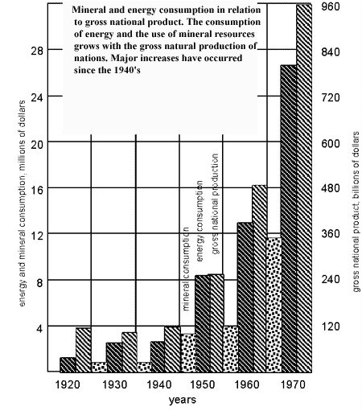

Slide 6
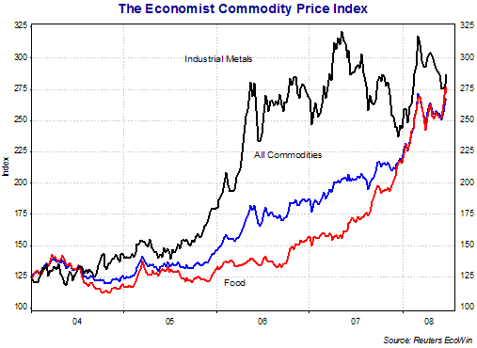

Slide 7
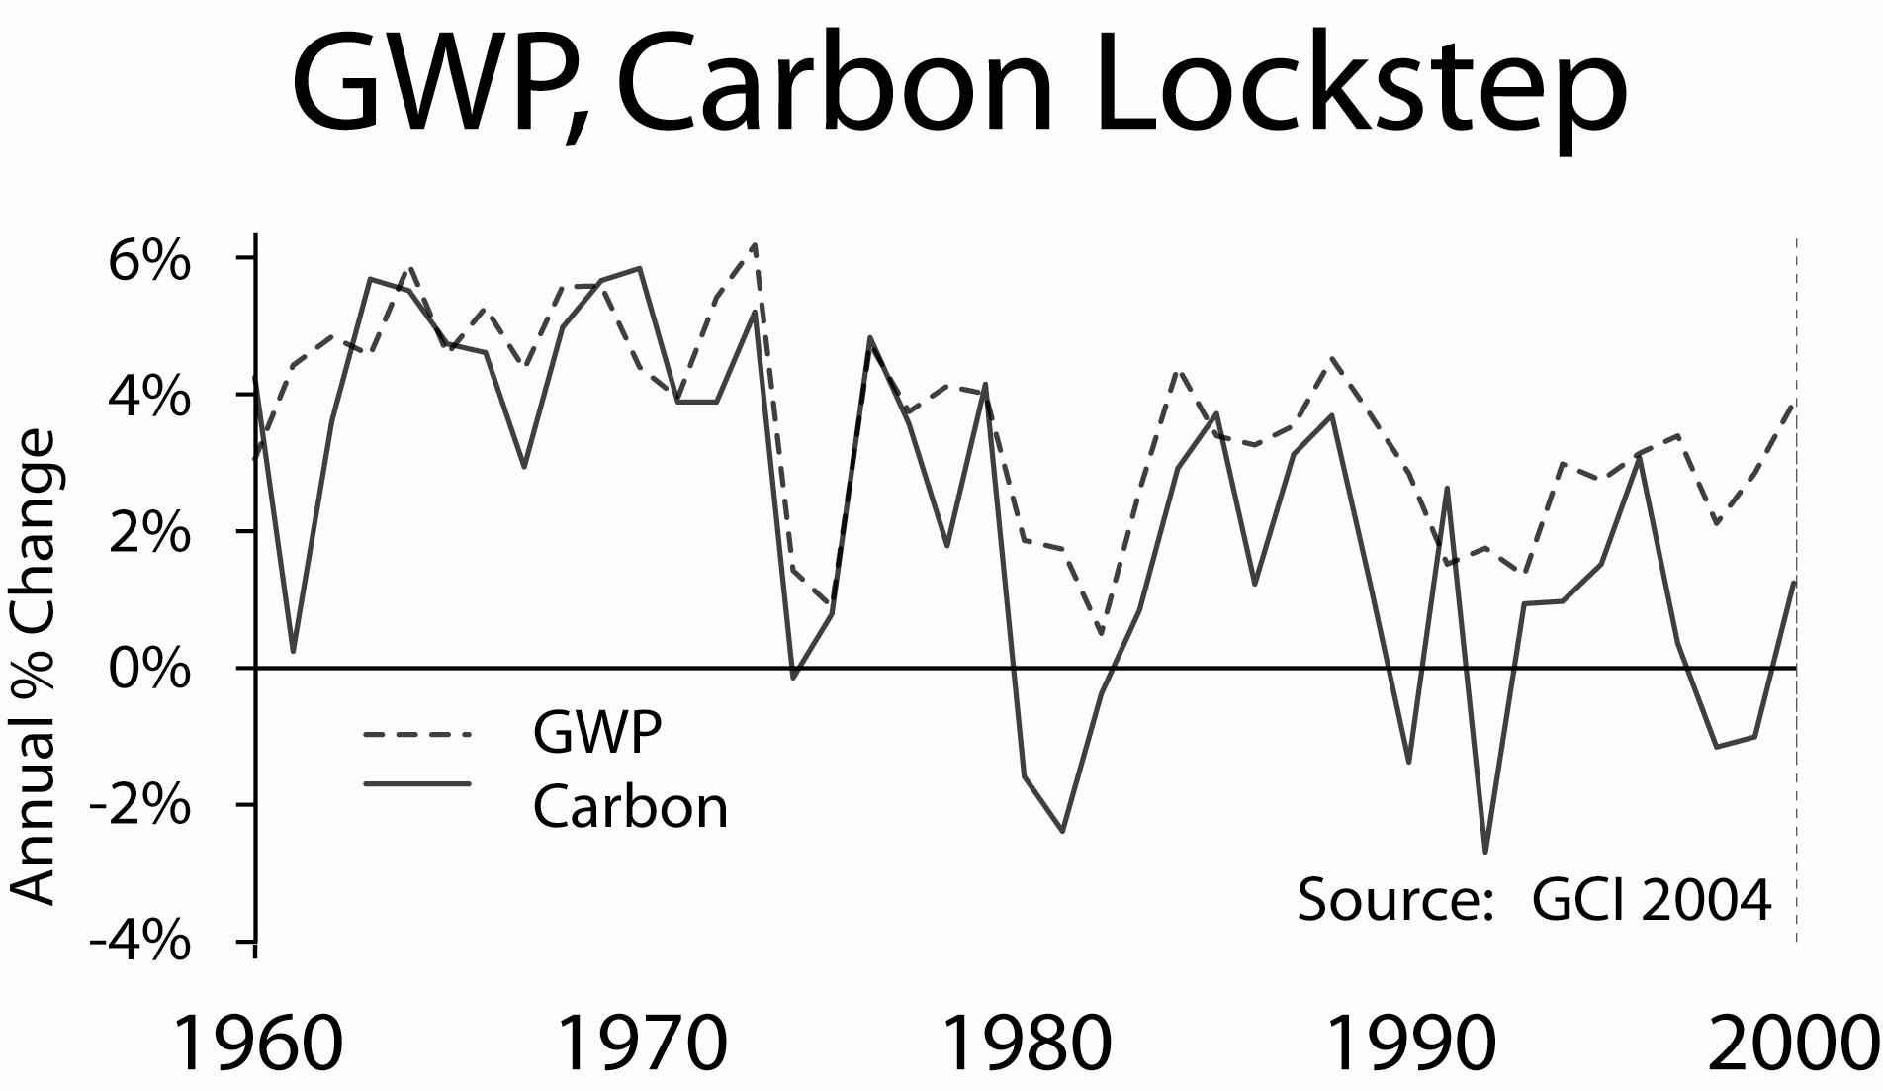

Slide 8
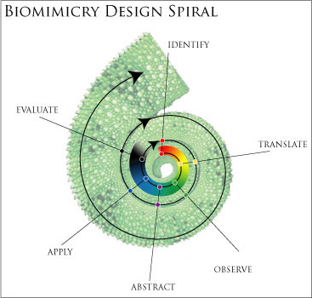
Industrial ecology: designing with nature in mind
A powerful prism through which to examine the impact of industry and technology on the biophysical environment
Examines local, regional and global uses and flows of materials and energy in products, processes, industrial sectors and economies

Slide 9
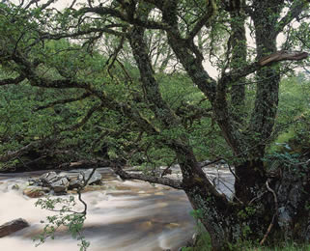
Natural metabolism
‘Products that, when their useful life is over, do not become useless waste but can be tossed on to the ground to decompose and become food for plants and animals and nutrients for soil’
Porritt encourages businesses to ‘match the metabolism of the natural world’--biomimicry
‘Buildings that, like trees, produce more energy than they consume and purify their own waste water’

Slide 10
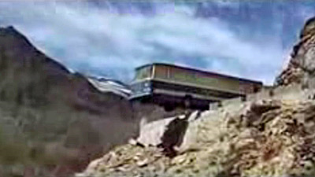
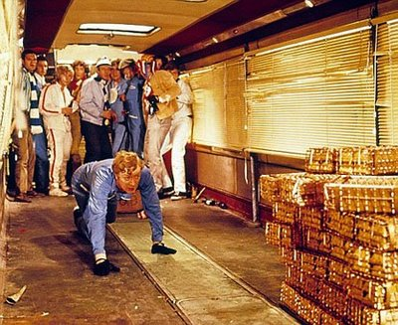
Hang on a Minute . . .

Slide 11
Globalization: where did it come from?
The origins of globalisation in the twenty-first century lie in the institutional arrangement of Bretton Woods, set up in 1944, as a means of managing the post WW2 international political economy of the developed countries. In essence, the arrangements were an attempt to impose a reciprocal conditioning between an industrial free-market system and a nation state system. . . This resulted in nation states’ domestic economies becoming increasingly subordinated to the needs of a globalising world economic system. (Arthur, et al., 2001).

Slide 12
Why is it political economy?
Other commentators have identified the central feature of globalisation as a change in the balance of power between increasingly internationalised firms and national governments:
[Globalisation’s] common feature is to convert the state into an agency for adjusting national economic practices and policies to the perceived exigencies of the global economy. The state becomes a transmission belt from the global to the national economy, where heretofore it had acted as the bulwark defending domestic welfare from external disturbances. (Cox, 1994: 49).

Slide 13
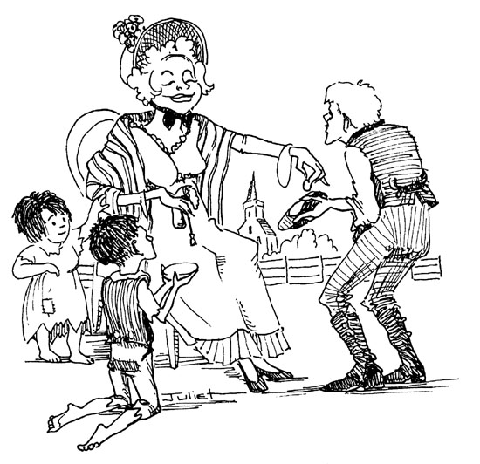
Concerns central to CSR . . .
environmental protection
philanthropy
involvement in social causes
urban investment
concern for employment standards
(Vyarkarnam, 1992)

Slide 14
and in the UK context
An empirical exploration of CSR performance amongst top UK companies used principal components analysis to identify a cluster of four variables
environmental action
women’s position
ethnic minorities’ position
philanthropy
(Balabanis et al., 1998)

Slide 15
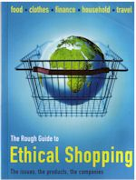
Why should firms get involved?
A firm that is perceived to be acting responsibly gains kudos in the eyes of its potential customers, increasing its sales base
(McGuire et al., 1988)
Indirect benefits because alternative to voluntary CSR is compulsory regulation

Slide 16

CSR: What is it Good For?
Social Return on Investment
Customer goodwill
Triple bottom line: financial,
social and environmental
Stakeholder boards
How can we measure it?
  Global Reporting Initiative (GRI) guidelines
  Social Accountability 8000 (SA 8000) standard
  AccountAbility1000 standard

Slide 17

The dangers of greenwash
By 1995 US-based firms were spending about $1 billion year on environmentally related PR
Accentuate the positive; deny and conceal the negative
Donate money to environmental groups and co-op them
Invent stakeholder dialogues to take up their time
Production of ‘educational materials’

Slide 18
Stock-market hostility to CSR
‘the impact of CSR activities with a significant cost element [in] particular environment care related activities . . . were found to be negatively related to subsequent financial performance (ROCE [ Return On Capital Employed]) (Balabanis et al., 1998: 42).
The hypothesis of the ‘ethical investor’ (that capital markets tend to reward socially responsible firms) is not necessarily empirically supported by this research. Quite the opposite, findings suggested that the capital market seems to be rather indifferent to firms that undertake some CSR activities. Even more surprisingly the degree to which a firm discloses CSR information had a negative effect on capital-market participants.

Slide 19
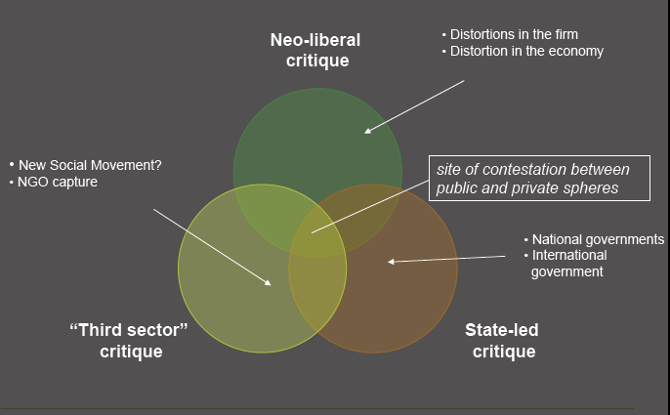

Slide 20
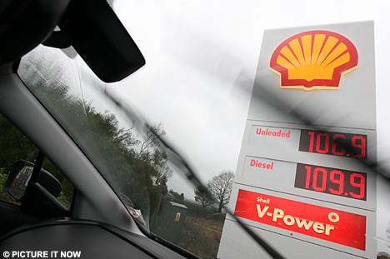
Shell: The World’s Biggest Company
Shell is one of the largest global corporations, a key player in the global oil industry and its third largest company behind Exxon-Mobil and BP.
‘Shell is a global group of energy and petrochemicals companies. With around 102,000 employees in more than 100 countries and territories, Shell helps to meet the world's growing demand for energy in economically, environmentally and socially responsible ways.’

Slide 21
Shell’s Commitment to CSR
‘Shell is strongly committed to social responsibility, with programmes ranging from education and women's development to environmental awareness. Hussain Al Mahmoudi, External Affairs Manager, Shell Dubai says that CSR helps bridge many cultural and social issues by building better relationships with governments, stakeholders and the local community.’
‘By the turn of the 21st century, corporate social responsibility (CSR) had been gaining rapid importance and Royal Dutch/Shell was one of the first oil companies to weave CSR into its business philosophy.’ IBSCDC CSR case-study

Slide 22

What Shell Does Well
In 2001 its revenues were almost US$135bn. and it had 90,000 employees in 140 countries.
Last year profits were annual earnings of £13.9bn, largest ever and more than £1.5m an hour.
Shell gives about £200,000 to environmental organizations every year and the Shell Foundation distributes £7.5m to development projects around the world.

Slide 23
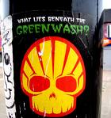
What Shell Does Badly
Brent Spar rig disposal
Appalling record in the Niger delta, including the murder of Ken Saro-Wiwa
Lying about its oil reserves
Founder member of the Global Climate Coalition
In January 2004 Shell was forced to admit it had over-estimated its reserves by 3.9bn. barrels, 20 per cent of the total.

Slide 24
In May 1996 Shell International Petroleum successfully complained about a joint advertisement by the Body Shop, Friends of the Earth and Greenpeace which criticized Shell’s activities in Ogoniland, Nigeria. The advertisement was ruled to be misleading as it implied that Shell was currently operating in Ogoniland. A later complaint (July 1996) by Friends of the Earth about a Shell International advertisement, which also referred to Shell’s activities in Ogoniland, was partially successful. The ASA agreed that Shell’s claims that sixty per cent of oil spills were caused by sabotage could not be adequately supported.

Slide 25
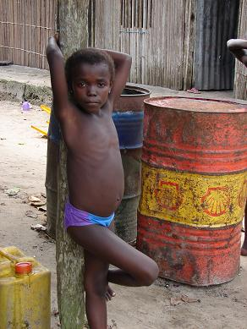
Shell in the Niger Delta
Since Shell began drilling oil in Ogoniland in 1958, the people of Ogoniland have had pipelines built across their farmlands and in front of their homes
In the Niger Delta, there were 2,976 oil spills between 1976 and 1991
A World Bank investigation found levels of hydrocarbon pollution in water in Ogoniland more than sixty times US limits
80% of Nigerian government revenues come directly from oil, over half of which is from Shell

Slide 26
Chief GNK Gininwa of Korokoro, in "The Drilling Fields"
When crude oil touches the leaf of a yam or cassava, or whatever economic trees we have, it dries immediately, it's so dangerous and somebody who was coming from, say, Shell was arguing with me so I told him that you're an engineer, you have been trained, you went to the university, I did not go to the university, but I know that what you have been saying in the university sleeps with me here so you cannot be more qualified in crude oil than myself who sleeps with crude oil.

Slide 27
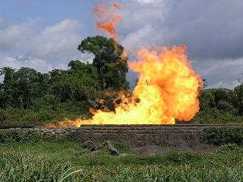
In Ogoniland, 95% of extracted natural gas is flared⁸ (compared with 0.6% in the United States). It is estimated that the between the CO₂ and methane released by gas flaring, Nigerian oil fields are responsible for more global warming effects than the combined oil fields of the rest of the world

Slide 28
Latest News . . .
Royal Dutch Shell is set to overtake BP as UK's biggest oil producer after about $40bn of investment in projects from Qatar and Brazil.
estimates its daily output will rise by about 1m barrels a day to 4.25m barrels by the end of 2012, ahead of the 4.1m BP predicts for the same year.
Record investment in 2009 is driving the increases, which will see expanding programmes, including an oil sands venture in Canada and the Sakhalin II project in Russia.

Slide 29
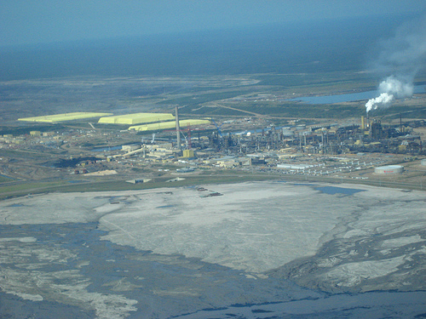

Slide 30

What Would an Ethical Business Look Like?
Stakeholders might also be shareholders
Genuine ownership
Accountability
Social responsibility
Could it be a co-operative?

Slide 31
Social enterprise and CSR
Collective values: socially useful production
Humanising the economy: emphasis on autonomy, associational values, and organising the economy at a ‘human’ scale
Enhancing democracy and participation via a decentralisation of policy to local communities and support for the local economy via the local production and consumption of goods and services
Acknowledging the relationships between economy, environment, politics and society
(Amin, Cameron and Hudson, 2002: 19-20)

Slide 32
Conclusions
Part of a reassessment of the relationship between business and society
Governments cannot be relied on to challenge the power of corporations: Shell’s unethical business practices were exposed by Greenpeace and the Ogoni
When considering social responsibility issues of scale and distance are important
Ownership and control matter: cooperative firms are rooted in the locality and community

