Slide 1
How Climate Change Will Affect Business for the Rest of this Century
Based on presentations by French energy ministry, David Suzuki, Tyndall Centre and FEASTA

Slide 2
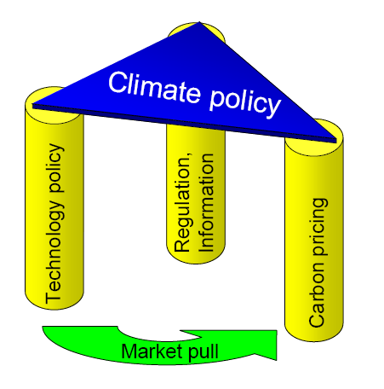
Three pillars of climate change policy

Slide 3
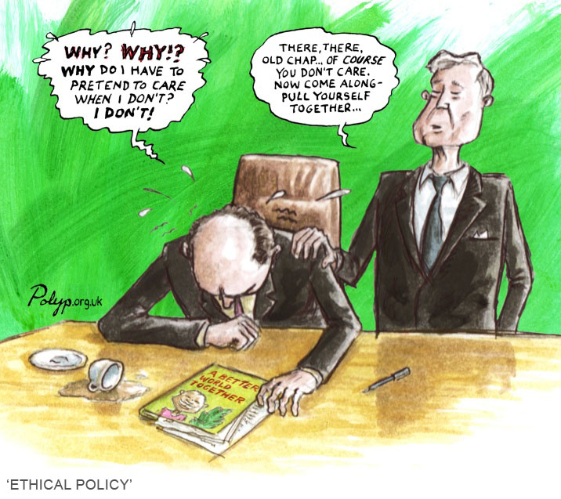
Internalising the externality
An externality is a cost that occurs outside the firm—it falls on neither the producer nor the consumer but a third party, usually the citizen
Emissions of carbon dioxide in production and transport are not costed—the ‘free good’ is overused

Slide 4
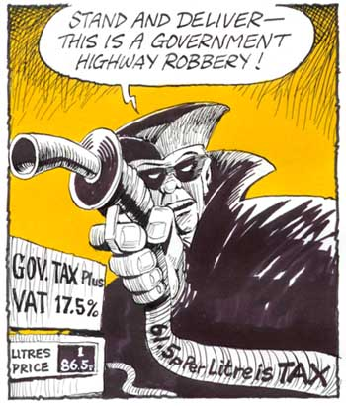
Problems facing policy-makers
Potentially large costs
Uncertainty
Lack of credibility

Slide 5
Upstream or Downstream?
Upstream – with producers – is simpler, e.g. when the fossil fuel comes out of the ground
How can we be sure this will be passed on to consumers?
Downstream is complex and costly
But downstream – i.e. with consumers – does impose individual responsibility
Downstream is also educational

Slide 6
Putting a price on carbon
Applying a price to emissions of greenhouse gases (GHGs), not just carbon dioxide (CO2 does make up 80% of GHGs)
Both carbon tax and cap-and-trade system are examples of carbon pricing
Polluter pays principle: stop treating the atmosphere as a free dumping ground
Including this cost gives an incentive for polluters to invest in using less energy and using cleaner energy (EE and RE): especially strong for heavy industry

Slide 7
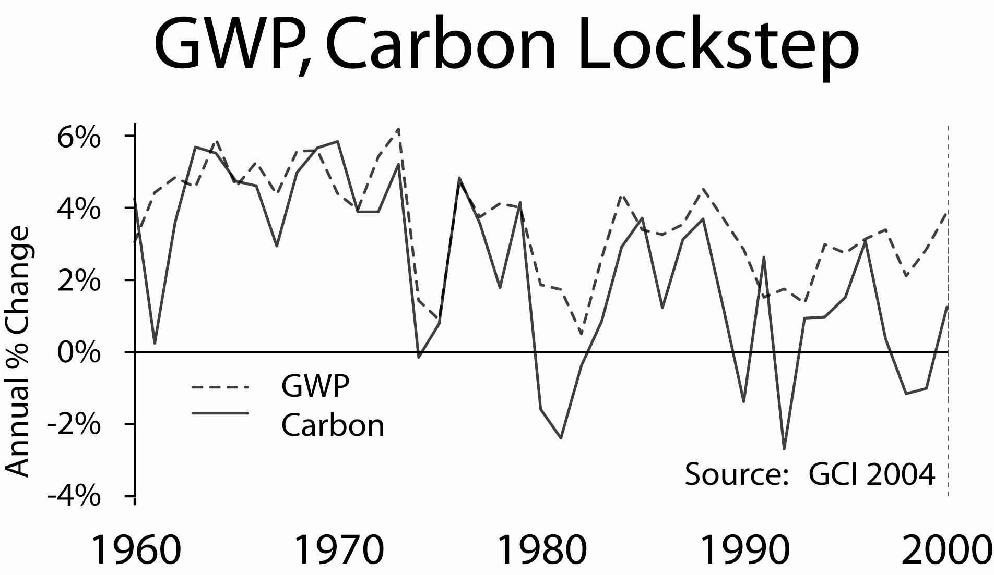
Impact on business?
Substitute lower-energy production systems?
Cost of fuel may increase three of five times—what about those long supply chains?
Increased cost of commuting and long-distance travel

Slide 8
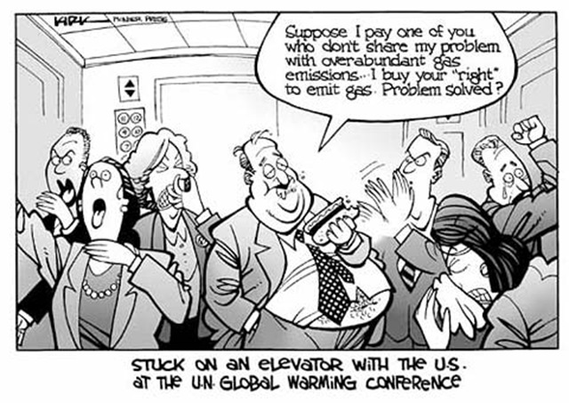
Market solution: Carbon Trading
Allocate permits to companies based on their existing emissions
Those who can control these most efficiently will sell surplus to others
Market efficiency

Slide 9
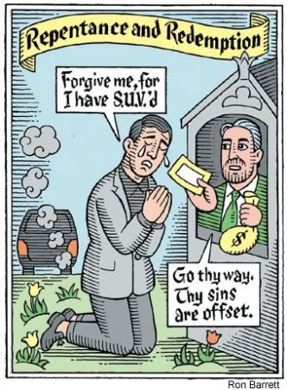
The EU Emissions Trading Scheme
The EU-ETS was set up to:
-reduce greenhouse gas emissions emitted in the EU
-do so at least cost by allowing trading in the right to emit carbon
-keep under a cap set by the Kyoto treaty

Slide 10
The European Emission Trading Scheme
Aimed to:
reduce greenhouse gas emissions emitted in the EU
do so at least cost by allowing trading in the right to emit carbon
keep under a cap set by the Kyoto treaty
It did this by:
- Issuing a limited number of permits to emit carbon dioxide
- giving them to 5,000 of the EU’s biggest emitters
- allowing trading between the recipients

Slide 11
EU-ETS: A Corporate Bonanza
Firms have charged consumers for emission rights they received for free
This has increased their profits. The WWF estimates that German utilities will make windfall profits of between €31-€64 billion to 2012 because of allowances.
It has also increased the cost of electricity to consumers and businesses
Bureaucratic expenses associated with National Allocation Plans, verification and compliance are being paid for by the public

Slide 12
EU-ETS: An Invitation to Corruption
Meeting the demands of powerful utility companies and acting in the perceived national interest creates a high moral hazard
The system is open to corruption at a national level. Finland, Lithuania, Luxembourg, Slovakia allocated 25% more than their recent emissions.
The system is open to corruption at the firm level since company allocations are set by governments.
A per capita sharing of permits would be much more transparent, and much fairer

Slide 13

EU-ETS: The big questions
Whose right is it to emit? Should it be given to an arbitrary group of companies, based on their past emissions? (“grandfathering”)
Should it be applied partially ‘downstream’
Should valuable permits worth €170 billion at issue be given away?
Should it cover only 43% of EU emissions?

Slide 14
Political solution: carbon tax
For most sources of GHG emissions, it is applied as a fuel tax, based on amount of fuel sold e.g. gasoline:
We know GHG emissions per litre of gasoline so convert the price per tonne into a price per litre ($10/tonne CO2 = 2.3 cents/litre of gas)
Apply to fuel wholesalers
Do this for tonnes of coal and cubic feet of nat. gas
For process emissions, also applied as a tax but need estimate of GHG emissions

Slide 15
Advantages and disadvantages
Advantages
  Can be implemented quickly (BC: 4 months)
  Industry and other fuel users know exactly the costs they face now and in near future
• Disadvantages
  We are less sure of what emission reductions will result

Slide 16
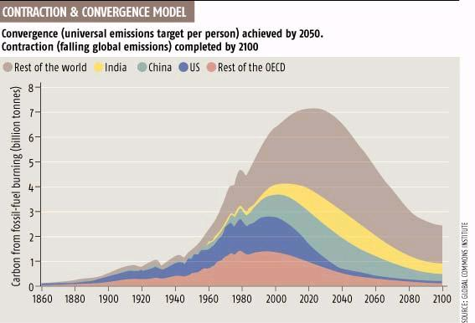
Communitarian solution: Contraction and Convergence
http://www.gci.org.uk/contconv/cc.html

Slide 17

Contraction and stabilisation at 450 ppmv
1
0
5
0
Atmospheric Concentrations
Business as Usual (BAU)
8
5
0
Stabilising atmospheric
concentrations with C&C
650
ppmv
450
250
Annual Emissions (BAU)
2
0
G
t
c
Contracting emissions with C&C
1
5
G
t
c
1
0
G
t
c
5
G
t
c
G
t
c
1
8
0
0
1
9
0
0
2
0
0
0
2
1
0
0
2
2
0
0
Notes:
Go to Flash 1

Slide 18
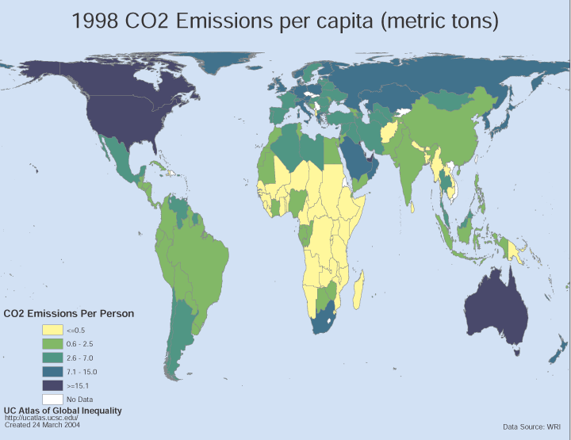
CO₂ Emissions Per Capita
Based on 1998 Data

Slide 19
Convergence by 2050
Per Capita Emissions
6
Annual
Per Capita
CO₂ Emissions
[tonnes
per capita
per annum]
Rest of World
4
India
2
China
Annex 1 (non-OECD)
0
OECD minus USA
Annual Gross
CO₂ Emissions
[Gigatonnes
per annum]
USA
10Gtc
Gross Emissions
5Gtc
1800
1900
2000
2100
2200

Slide 20

Cap & Share
Issues entitlements for all the emissions allowed in a year under the EU’s Kyoto target or that set by its successor.
Gives equal entitlements to each EU resident
Recipients then sell their entitlements at the current market rate, via banks or post-offices
The entitlements are sold by the banks to companies producing or importing fossil fuels in the EU
Each importer or producer needs to buy enough permits to cover the eventual emissions from the fuels they sell.

Slide 21
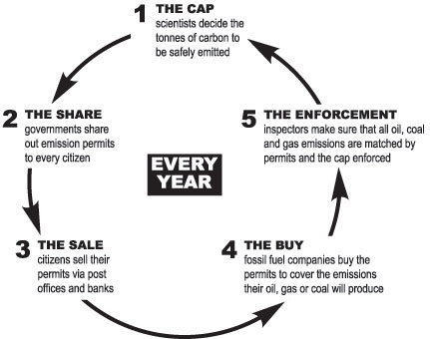

Slide 22
Personal carbon trading
Total emissions in the US: 20 t CO2 per capita
Non-personal: services, goods and infrastructure--11 t CO2 per capita
Personal: home energy and transport-- 9 t CO2 per capita
An equitable share to stabilize at 450 ppm – Mayer Hillman ~1 t CO2 per capita

Slide 23
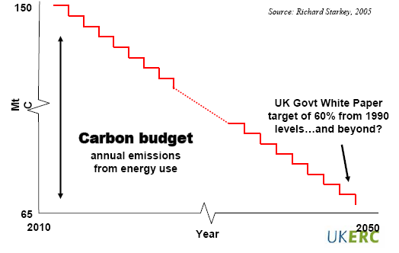
Three key elements of personal carbon trading
1- Setting the carbon budget
2- Surrendering carbon units
3- Allocating carbon units

Slide 24
Setting a carbon budget

Slide 25
Allocating or acquiring carbon units
Individuals receive a free and equal per capita carbon allowance
Individuals exceeding their free allowance will have to buy additional carbon units from the market
Individuals having surplus carbon units will be able sell or save them

Slide 26
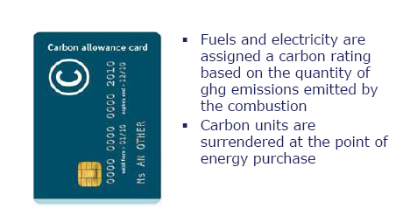
Surrendering carbon units

Slide 27
Making carbon a part of everyday life
Smart bills
Smart meters
Smart receipts
Enhanced petrol pumps
Carbon-ometers
Carbon responsibility in advertising
Carbon labels
Carbon promises
Carbon-rated homes
Carbon watchers

