Slide 1
Creating new markets
Can property rights save the planet?

Slide 2
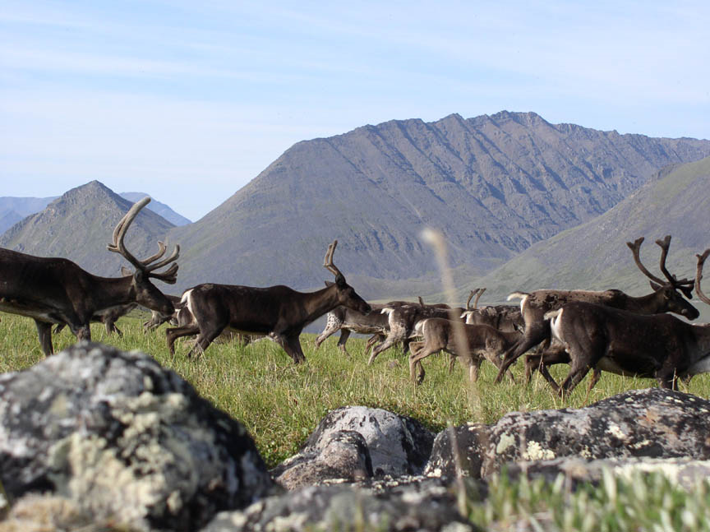
Why are some habitats still unspoiled?

Slide 3
For an environmental economist. . .
The reason the planet is being destroyed is that it does not belong to anybody
If property rights could be clearly established then ecosystems could be protected
But where are the unspoiled habitats?

Slide 4
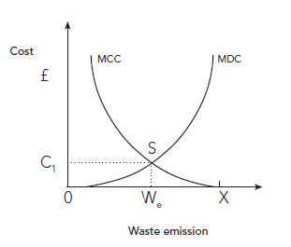
Coase Theorem

Slide 5
The MCC curve is the cost the paper mill will face in using other means of cleaning rather than the river; the MDC curve is the marginal cost of damage caused to the fish farm by discharges from the paper-mill.
The natural equilibrium is at point S, where pollution is at level W_{e}.
If we first try assign the ownership of the river to the fish-farm it would prevent all emissions from the paper-mill (position 0 in the graph). But if the mill were to discharge less than W_{e} of waste, the cost of alternative means of cleaning would be greater than the damage to the fish-farm (MCC > MDC), giving the mill an incentive to pay the farm for the damage resulting from some level of pollution. There is a range of costs for this compensation (in the range from 0 to C₁ on the diagram) representing the range of options where the marginal cost of alternative clean-up is greater than the damage to the fish-farm.
If we assign the property right to the paper-mill, it could discharge all its waste into the river, polluting the river to a level represented by the point X on the axis. But for all levels of waste between W_{e} and X (MDC > MCC) the paper-mill would gain more financially by engaging in a negotiation to reduce its level of its emissions and take a fee from the fish-farm in return. So from this perspective also the optimum level of pollution is W_{e}, where MDC = MCC.
Hussen, Principles of Environmental Economics, 2000

Slide 6
Problems?
Do the two businesses have equal power?
Do they have equal access to the law?
Can we always measure the pollution accurately?
What about those without property rights who are affected by pollution?
Is any level of pollution necessary?

Slide 7
Eco-system services: UNEP
How to establish their value?
Millennium Ecosystem Assessment (MA) reported that ‘60 to 70% of our world’s ecosystem services are deteriorating, with dramatic consequences for those who are most dependent on their steady provision, such as subsistence farmers.’
‘The attractiveness of the “ecosystem services” concept is also largely due to its capacity to provide a unifying language between the economic, business and environmental communities; as beneficiaries of valuable services are identified, previously uninvolved actors are recognizing that they have a stake in conserving the environment’

Slide 8
Type of mechanism | Compensating benefit to host country | Global environmental benefits
Bio-prospecting | Share of commercial returns from pharmaceutical and other products | Biodiversity, protected areas
Carbon offsets | Foreign capital investment | Reducing CO2 pollution
Debt-for-nature swaps | Purchase of secondary debt in exchange for protected areas | Biodiversity, carbon store
Transferable development rights | Alternative rights to areas with less environmental value | Protected areas

Slide 9
Discussion
Which aspects of your local environment are under threat?
Could you create a market that would save them
What would the product be?
Who would trade it?
Where would the trade take place, and what money would be used?

Slide 10
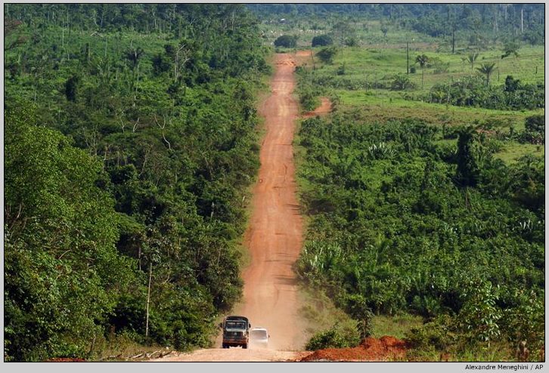
Recipe to create a ‘missing’ market
A preference for something and a willingness to pay to secure it
Creating a product:
  supply of resources, e.g. drugs from the Amazon
  assimilation of wastes, e.g. forests
  direct source of ‘utility’ in terms of enjoying the view or feeling spiritually uplifted, e.g. an unspoilt view

Slide 11
‘Values’ created by the environment
Direct values relate to resources that can be physically extracted from the ecosystem and then sold or made into wood from rainforests, medicinal plants
Indirect values relate to other ‘services that the ecosystem provides but do not have a solid physical existence’: trees that can absorb CO2
Option values money people will pay to protect the environment so that they can have future direct or indirect value in future
Existence values are an attempt to put into monetary terms the intrinsic value of a species or environment

Slide 12
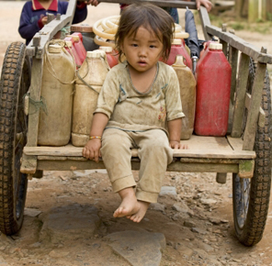

Whose life is worth more?
Land in the countries of the South was valued at one tenth of the rate of the land in rich Western countries by IPCC economists
The cost of a lost life in Western countries was US$1.5mfor the rest of the world it was US$100,000

Slide 13
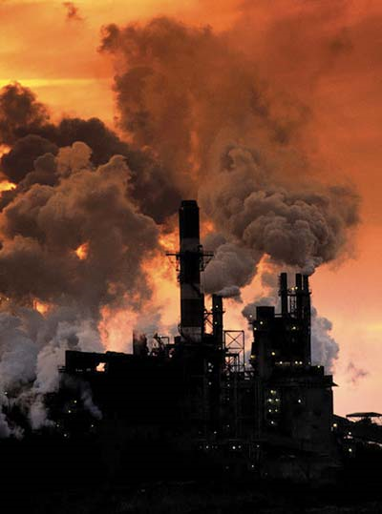
Conventional market approach
Pay the actual cost of restoring the environment, e.g. to clean up pollution from a factory
Could add more for the intrinsic value of the watershed which absorbs the pollution, using a ‘shadow pricing’ technique
If a crop destroyed by pollution, pay the farmer the value he would have received

Slide 14
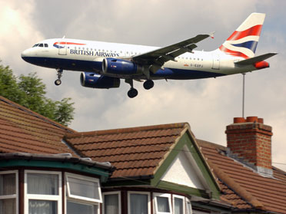
Household production function
Cost the substitute that can be offered to the consumer who has lost out because something they value in the environment has been destroyed
Examples might be the cost of installing insulation to prevent noise from aircraft destroying the peaceful enjoyment of the home or the cost of travelling to a park that is far from a person’s home because the nearby park has been used as development land by a supermarket.

Slide 15
Hedonic pricing methods
Hedonic pricing involves using markets that do exist that approximate to the goods or services that are destroyed and using the prices that are paid in that market to impute a price to the non-tradable commodity. The price that exists in the real market is considered as an implicit price for the missing market
A popular example is the ‘hedonic housing market’, which relates the price premium for homes in a certain area to the value people place on the peace, proximity of green space for leisure, low levels of noise pollution and so on in the local environment.

Slide 16
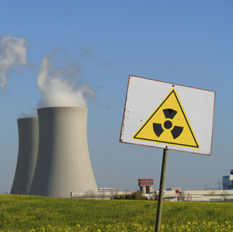
Experimental methods
Go out and ask people directly what they would be prepared to protect it
In a method known as ‘contingent valuation’ people are asked what they would be willing to pay to protect their local park or to avoid having a nuclear power-station built in their community, for example
The method known as ‘contingent ranking’ or ‘stated preference’ involves how much they value an environmental good relative to other goods which are actually bought and sold in a market

Slide 17
Preparation for fieldwork
What do you make of these techniques?
What are the pressing local environmental issues?
How would you phrase questions to assess people’s willingness to pay to protect them?
How will you choose people to ask?
How will you report your results?

Slide 18
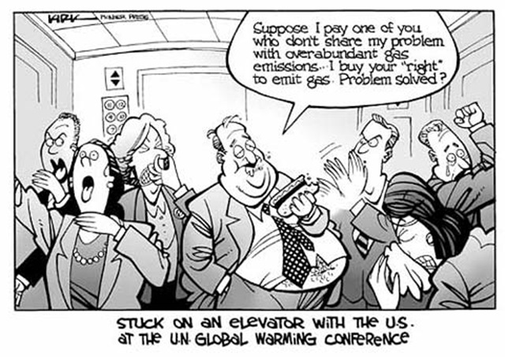
Market solution: Carbon Trading
Allocate permits to companies based on their existing emissions
Those who can control these most efficiently will sell surplus to others
Market efficiency

Slide 19
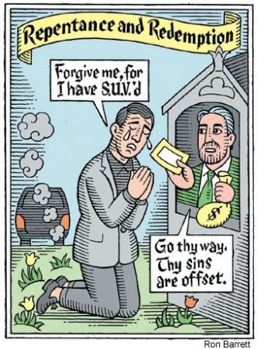
The EU Emissions Trading Scheme
The EU-ETS was set up to:
-reduce greenhouse gas emissions emitted in the EU
-do so at least cost by allowing trading in the right to emit carbon
-keep under a cap set by the Kyoto treaty

Slide 20
The European Emission Trading Scheme
Aimed to:
reduce greenhouse gas emissions emitted in the EU
do so at least cost by allowing trading in the right to emit carbon
keep under a cap set by the Kyoto treaty
It did this by:
- Issuing a limited number of permits to emit carbon dioxide
- giving them to 5,000 of the EU’s biggest emitters
- allowing trading between the recipients

Slide 21
EU-ETS: A Corporate Bonanza
Firms have charged consumers for emission rights they received for free
This has increased their profits. The WWF estimates that German utilities will make windfall profits of between €31-€64 billion to 2012 because of allowances.
It has also increased the cost of electricity to consumers and businesses
Bureaucratic expenses associated with National Allocation Plans, verification and compliance are being paid for by the public

Slide 22
EU-ETS: An Invitation to Corruption
Meeting the demands of powerful utility companies and acting in the perceived national interest creates a high moral hazard
The system is open to corruption at a national level. Finland, Lithuania, Luxembourg, Slovakia allocated 25% more than their recent emissions.
The system is open to corruption at the firm level since company allocations are set by governments.
A per capita sharing of permits would be much more transparent, and much fairer

