Slide 1
Deconstructing Friedman
Ironing out the Creases in the View of the World as Flat

Slide 2

Deconstruction is the name given by French philosopher Jacques Derrida to an approach (whether in philosophy, literary analysis, or in other fields) which rigorously pursues the meaning of a text to the point of undoing the oppositions on which it is apparently founded, and to the point of showing that those foundations are irreducibly complex, unstable or impossible.

Slide 3
No one ever gave me directions like this on a golf course before: ‘Aim at either Microsoft or IBM.’ I was standing on the first tee at the KGA Gold Club in downtown Bangalore, in southern India, when my playing partner pointed at two shiny glass-and-steel buildings off in the distance, just behind the first green. The Goldman Sachs building wasn’t done yet; otherwise he could have pointed that out as well and made it a threesome. HP and Texas Instruments had their offices on the back nine, along the tenth hole

Slide 4
The tee markers were from Epson, the printer company, and one of our caddies was wearing a hat from 3M. Outside, some of the traffic signs were also sponsored by Texas Instruments, and the Pizza Hut billboard on the way over showed a steaming pizza, under the headline ‘Gigabites of Taste!’
‘to see the said princes, people and territories and to learn their disposition and the proper method of converting them to our holy faith’

Slide 5


Slide 6
No one ever gave me directions like this on a golf course before: ‘Aim at either Microsoft or IBM.’ I was standing on the first tee at the KGA Gold Club in downtown Bangalore, in southern India, when my playing partner pointed at two shiny glass-and-steel buildings off in the distance, just behind the first green. The Goldman Sachs building wasn’t done yet; otherwise he could have pointed that out as well and made it a threesome. HP and Texas Instruments had their offices on the back nine, along the tenth hole

Slide 7
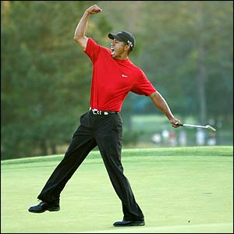
Who Plays Golf?
Only 4% of those who play golf in the US are women
African–Americans comprise 5 per cent of golfers; 4 per cent are
Asian–Americans and 3.5 per cent areHispanic–Americans
Wheeler, K. And Nauright, J. ‘A Global Perspective on the Environmental Impact of Golf’, Sport and Society, 9/3: 427–443

Slide 8
Scotland, 500 years ago
‘There, Mother Nature designed the links – grasses on sandy stretches were fertilized by the droppings of breeding seabirds and cut short by grazing rabbits. Bunkers were allegedly formed by sheep and other animals burrowing into the turf. The result: wide open playing areas with random clumps of razed grass, the perfect terrain for thumping a small, hard ball across the countryside.’

Slide 9
A Market Opportunity
‘Golf has also seen tremendous growth overseas, as there are now well over 25,000 courses worldwide, collectively covering an area close to the size of Belgium. Europe has been bitten hard by the golf bug and is now home to more than 5,000 courses, while Japan has also seen extraordinary growth. Other parts of Asia are viewed as the new areas of market expansion of golf, with China and India seen as the next great untapped markets.’

Slide 10
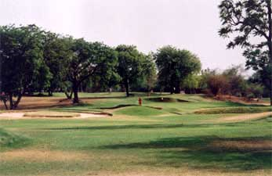
Environmental consequences
Clearing of natural vegetation, deforestation, destruction of natural landscapes;
Destruction of habitats
Damages to water systems
Soil erosion
Algal blooms and disturbance to ecology
Chemical pollution

Slide 11
Golf fever in Malaysia
Malaysia had only a handful of golf courses in the early 1980s, but this number swelled to over 150 golf courses by 1994 and 189 by the early 2000s
In order to build the Langkawi Island course and resort, hundreds of rainforest acres were cleared.
The harvest of nearby rice fields dropped more than 60 per cent
The government paid $7.5 million for a water pipeline connecting a resort on Redang Island with the mainland area of Terengganu, where a cholera epidemic had recently broken out because of an inadequate water supply

Slide 12
No one ever gave me directions like this on a golf course before: ‘Aim at either Microsoft or IBM.’ I was standing on the first tee at the KGA Golf Club in downtown Bangalore, in southern India, when my playing partner pointed at two shiny glass-and-steel buildings off in the distance, just behind the first green. The Goldman Sachs building wasn’t done yet; otherwise he could have pointed that out as well and made it a threesome. HP and Texas Instruments had their offices on the back nine, along the tenth hole

Slide 13
Global Fortune 500, 2008
1 | Wal-Mart Stores | 378,799 | 12,731
2 | Exxon Mobil | 372,824 | 40,610
3 | Royal Dutch Shell | 355,782 | 31,331
4 | BP | 291,438 | 20,845
5 | Toyota Motor | 230,201 | 15,042
6 | Chevron | 210,783 | 18,688
7 | ING Group | 201,516 | 12,649
8 | Total | 187,280 | 18,042
9 | General Motors | 182,347 | -38,732
10 | ConocoPhillips | 178,558 | 11,891.

Slide 14
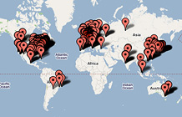

Slide 15
Global Fortune 500, 2009
Company | Country | Field
Royal Dutch Shell | Netherlands† | Oil
ExxonMobil Corporation | United States | Oil
Wal Mart | United States | Retail
BP | United Kingdom | Oil
Chevron Corporation | United States | Oil
Total S.A. | France | Oil
ConocoPhillips | United States | Oil
ING Group | Netherlands | Banking
Sinopec | China | Oil
Toyota Motor | Japan | Automobiles

Slide 16

Why travel?
Have you ever visited India, or another ‘developing country’
Did you suffer culture shock?
Which differences struck you most?
How easy was it to live as you live in your home country?

Slide 17
No one ever gave me directions like this on a golf course before: ‘Aim at either Microsoft or IBM.’ I was standing on the first tee at the KGA Golf Club in downtown Bangalore, in southern India, when my playing partner pointed at two shiny glass-and-steel buildings off in the distance, just behind the first green. The Goldman Sachs building wasn’t done yet; otherwise he could have pointed that out as well and made it a threesome. HP and Texas Instruments had their offices on the back nine, along the tenth hole

Slide 18
Bangalore: Global Capital of India
From Independence, entrepreneurs began creating corporations in the city:
Hindustan Aeronautics, National Aerospace Laboratories, Bharat Heavy Electricals, Bharat Electronics.
In 1972 the Indian Space Research Organisation HQ was established in Bangalore
It is India’s ‘silicon valley’: 33 per cent of India’s IT exports in 2006/7
Infosys and Wipro are both based in Bangalore

Slide 19
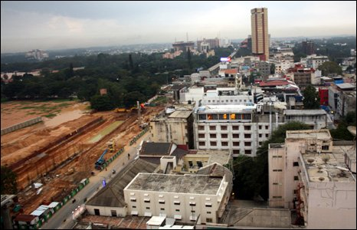
Since the liberalisation of the Indian economy in the 1990s, the Indian tech sector has expanded rapidly.
The major players - including Microsoft, Infosys, Cisco and Google - exist in enormous "tech parks" crammed with tall, shiny office buildings.
Meanwhile on the same block, piles of rotting rubbish, beggars and stray dogs surround traffic that is heavy with pollution and often locked in a loud and aggressive jam.

Slide 20
David Holman, Rosemary Batt, and Ursula Holtgrewe, The Global Call Centre Report
Among all countries, India stands out as unique, with almost three-quarters of the jobs offering very little opportunity for employees to make independent decisions about their work
India has the highest performance monitoring activity of several times a week.
Median pay: US$2,489; median pay in US: US$35,000

Slide 21
Centre for Internet and Society
Critically engage with concerns of digital pluralism, public accountability, and pedagogic practices, in the field of Internet and Society, with particular emphasis on South-South dialogues and exchange.
  Digital disablement and accessibility
  Intellectual property
  Open source and creativity

Slide 22
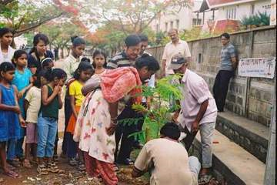
Citizen Matters Bangalore
Concern for loss of urban green – guidance on community tree-planting
‘Girls on the run’
Campaign for better urban facilities for the poor

Slide 23
No one ever gave me directions like this on a golf course before: ‘Aim at either Microsoft or IBM.’ I was standing on the first tee at the KGA Golf Club in downtown Bangalore, in southern India, when my playing partner pointed at two shiny glass-and-steel buildings off in the distance, just behind the first green. The Goldman Sachs building wasn’t done yet; otherwise he could have pointed that out as well and made it a threesome. HP and Texas Instruments had their offices on the back nine, along the tenth hole

Slide 24
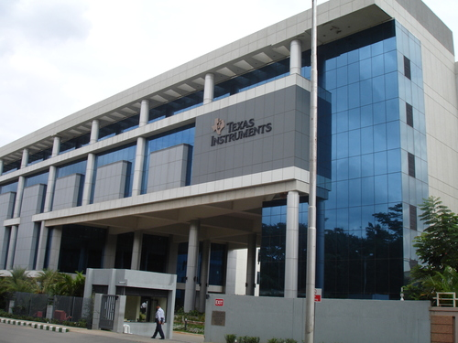
Appropriate Technology?
Greenhouse vs. passive cooling
High embodied energy in building materials
Need to transport building materials
Skills available amongst local workers?

Slide 25
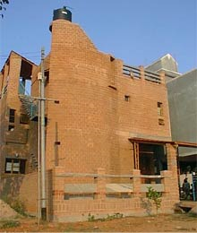
Chitra Vishwanath
The aim of our practice is to design looking at spaces as ecological spaces not just physical spaces.
Response to climate, conserving and using natural resources judiciously, and eliminating waste streams are sought to be consciously built in to each project.
The buildings are usually built with earth, harvest rain, sun and wind, encourage recycling and reuse, attract local plants and birds and be unique but comfortable spaces.

Slide 26
B. V. Venkatarama Reddy, Department of Civil Engineering & Centre for Sustainable Technologies, Indian Institute of Science, Bangalore
Energy efficient, consuming less than half of the energy required for conventional building methods
Techniques are simple and employ maximum local resources and skills
Decentralized production systems and small-scale operations that generate local employment
Reduce cost and energy involved in transportation of building products.

Slide 27
No one ever gave me directions like this on a golf course before: ‘Aim at either Microsoft or IBM.’ I was standing on the first tee at the KGA Golf Club in downtown Bangalore, in southern India, when my playing partner pointed at two shiny glass-and-steel buildings off in the distance, just behind the first green. The Goldman Sachs building wasn’t done yet; otherwise he could have pointed that out as well and made it a threesome. HP and Texas Instruments had their offices on the back nine, along the tenth hole

Slide 28
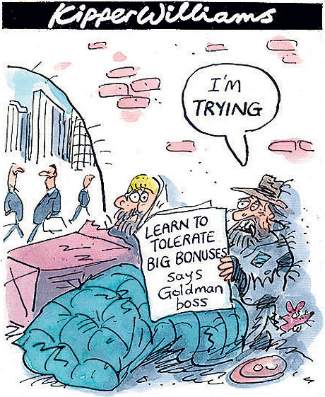
Bonuses?
Goldman Sachs is currently on track to pay the biggest ever bonuses to its 31,700 employees after earning profits at a rate of $35m (£21m) a day.
Lord Griffiths, vice-chairman of Goldman Sachs: people should learn to ‘tolerate the inequality as a way to achieve greater prosperity for all’

Slide 29
It’s hard to see what isn’t there
Financialisation
Monoculture and loss of regional diversity and identity
Increased risk of terrorism
Increased risk of pandemics—SARS and swine flu—and what about TB?

Slide 30
The central role of finance
‘capitalism is defined by the production for exchange financed by credit’, Mellor et al 2002
Schumpeter theorises the entrepreneur as needing finance to create new economic activity
The control of finance is vital to capitalist activity: the banker ‘ stands between those who wish to form new combinations and the possessors of productive means’

Slide 31
‘Big Bang’—financial deregulation
Relinquishing of credit and exchange controls
Removal of ‘reserve ratio’ and regulation and restraint of bank lending
No political institutions at the global level to match the global power of finance

Slide 32
A new dominance
‘The finance industry lies at the heart of globalisation. Of the total international transactions of a trillion or so dollars each day, 95 per cent are purely financial. Globalisation in not about trade; it is about money’
‘the financial system now completely dominates the real economy of goods and services’
Prevailing of upper circuits—casino economy

Slide 33
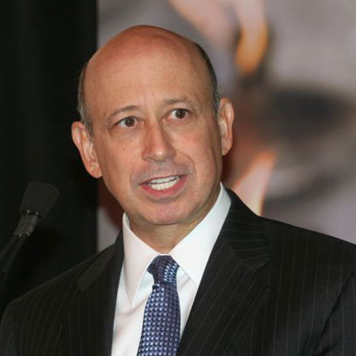
Lloyd Blankfein
Total remuneration: £163.1m
Bank market capitalisation (August 2007): £37.8bn
Bank market capitalisation (now): £24.6bn
Credit crunch hits (since August 2007): £19.4bn

Slide 34
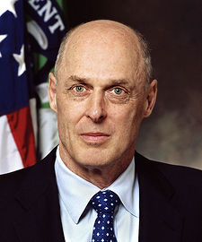
The market, or politics?
Hank Paulson, Bush’s Treasury Secretary, was Chairman and CEO of Goldman Sachs
Goldman Sachs received billions of dollars during the unwind of insurance arrangements purchased from AIG, including $12.9bn from funds provided by the US Federal Reserve
It still has benefits from $28 billion in subsidization from the government in form of cheap debt backed by the Federal Deposit Insurance Corporation

Slide 35

Monoculture and brand domination

Slide 36
A few decades ago, it was still possible to leave home and go somewhere else: the architecture was different, the landscape was different, the language, lifestyle, dress, and values were different. That was a time when we could speak of cultural diversity. But with economic globalization, diversity is fast disappearing. The goal of the global economy is that all countries should be homogenized. When global hotel chains advertise to tourists that all their rooms in every city of the world are identical, they don't mention that the cities are becoming identical too: cars, noise, smog, corporate high-rises, violence, fast food, McDonalds, Nikes, Levis, Barbie Dolls, American TV and film. What's the point of leaving home?

Slide 37

Not just an issue about travel losing its charm!
Loss of identity can lead to a greater salience for identity-based political activity
Learning Czech from Microsoft

Slide 38
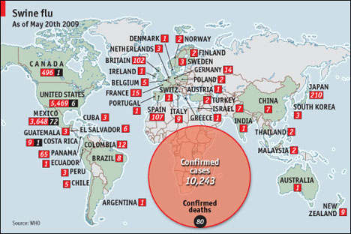
Global spread of swine flu

Slide 39
US Centers for Disease Control
SARS-CoV can spread rapidly on a global scale through international travel if control measures are not implemented
SARS-CoV transmission can be halted through aggressive global measures to educate, detect cases early, effectively isolate cases, and identify, monitor, and quarantine contacts
Patients with SARS can transmit infection to other passengers and should postpone travel until they are no longer infectious
SARS-CoV transmission can occur within the close confines of conveyances

