Slide 1
Education as Re-embedding
Stroud Communiversity, Walking the Land and the Enduring Spell of the Sensuous
Molly Scott Cato
Reader in Green Economics
Cardiff School of Management

Slide 2
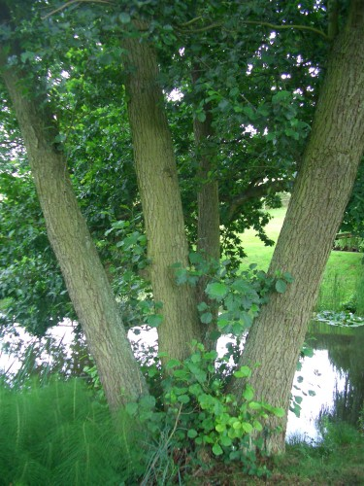
How we know is at least as important as what we know
Hence our approach to teaching needs to begin with a re-exploration of our own approach to knowing our world: our pedagogy must be preceded by an ontology and an epistemology.

Slide 3
‘How do we know what exists?’ and ‘How do we know what is true?’
Deleuze’s suggestion that knowledge advances through a passionate commitment in relation to the physical world
Merleau-Ponty’s suggestion that the basis of perception is relationship—but relationships with whom or what?

Slide 4
How might our way of knowing might limit the extent of what we can know and how we learn and teach?
For example, how might knowledge conveyed through an abstract system of writing differ from knowledge derived
a community of song, like the Aboriginal songlines?
a knotted string like the Incan quipu?

Slide 5
‘When travelling in Canada, the author discovered that people from different cultural backgrounds frame natural resources in very different terms: First Nations people in western Canada see the forests of British Columbia as sacred spaces. People from a European background see them as resources to be ‘used’ or ‘developed’ even if for leisure. The giving of land back to First Nations people in Canada elicited the complaint that they do not “do” anything with it. The idea that sometimes the point is to “be” rather than to “do” seems to have proved very hard to communicate.’ (Stock, 2009: 287)

Slide 6
Reality through Relationship
‘social reality is not separate from us, but that social realities and ourselves are intimately interwoven as each shapes and is shaped by the other in everyday interactions’ (Cunliffe, 2008: 124)
‘The world and I reciprocate one another. The landscape as I directly experience it is hardly a determinate object; it is an ambiguous realm that responds to my emotions and calls forth feelings from me in turn’ (Abram, 1996: 33)

Slide 7
Reality is determined within social systems, and is thus subject to prevailing cultural norms, as well as dominant power structures. In teaching situations, in order to enable a creative flourishing a shared knowledge, it is necessary for the pedagogue to be self-reflexive and self-critical, a process Cunliffe refers to as ‘relationally responsive interaction’.

Slide 8
‘Relationally responsive learning’

Slide 9
‘Relationally responsive social constructionism highlights the intersubjective, dialogical and dialectical nature of experience, and consequently has implications for the type of knowledge we seek. I suggest this orientation emphasizes an embedded form of knowing, which is often intuitive, but can be explored through reflexive engagement with ourselves and our surroundings.’ (Cunliffe, 2008: 136).

Slide 10
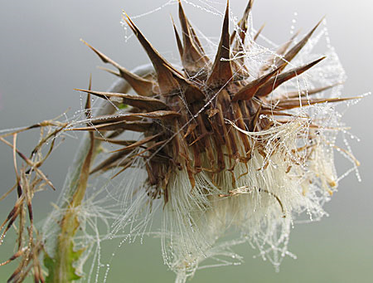
But who are we responding to?
Suze Adams: ‘Every breath is an exchange with our environment’

Slide 11
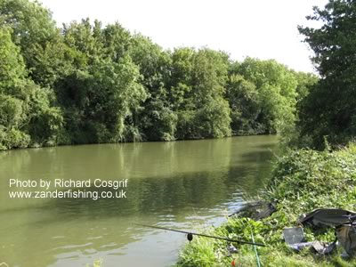
When roots are shared in land and life, we are still but move with everything through time—
Fred Chance,
Over the Sharpness Canal

Slide 12
Sustainability literacy
‘In the absence of formal writing systems, human communities come to know themselves primarily as they are reflected back by the animals and the animate landscapes with which they are directly engaged. This epistemological dependence is readily evidenced, on every continent, by the diverse modes of identification commonly categorized under the single term “totemism”’ (Abram, 1996: 123).

Slide 13

Merleau-Ponty on how we know
‘as embodied habituations with the natural world increase they will slowly lead to the absorption of this larger organism into our bodies, and our bodies into it.’ (Carolan: 2008: 65)

Slide 14
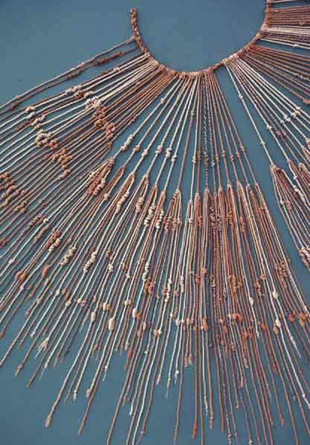
Thinking in Strings
Quipu is the Inca word for ‘knot’
The Inca culture existed from about 1400 to its extinction by Spanish
conquerors about 1560 AD
It was a highly complex, bureaucratic empire extending over modern Peru and parts of Ecuador, Bolivia, Chile, and Argentina and including perhaps 5 million people
It has been considered an ‘illiterate’ culture

Slide 15
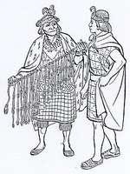
It was a decimal accounting system, which involved the use of zero
Quipucamayoqs: for all its apparent exoticism, this may have been a communication system of middle-aged male accountants
Were myths deliberately kept oral?

Slide 16
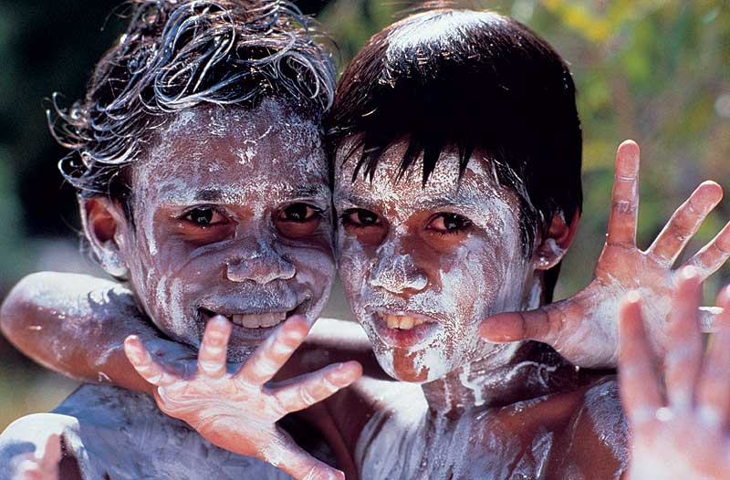
Thinking in the Land
Traditional people talk about their inner life as a story of movement between significant places, a journey through landscapes of meaning, conveying the events that occur on that journey, and at the ritual meeting places encountered along the way
Their inner life is lived in their outer life: land, people, fauna and flora are one, and the dreaming and waka provide a context in which meaning arises.

Slide 17
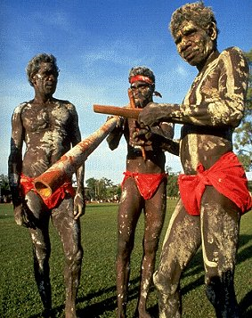
More than Your Backyard
The songline represents your totemic animal
This is your special responsibility
Contributes to identity
Remembering the songs keeps the landscape alive

Slide 18
‘Under Western eyes, the Amazon is an un-understandable wilderness, an undifferentiated green of undefinable plants, a bewildering forest of obscurity where not only your body but also your comprehension can become fatally lost. But indigenous people know how to ‘think’ the forests, know that the paths through this wilderness are songs, the song that each plant has. Song makes a thread of light, a path of the mind; each song tells of one plant’s relationship to other plants and not only differentiates one plant from another but distinguishes between the uses of, for example, stem or leaf or root of the same plant. . . The songlines harmonize people with environment. There is no divide. Mankind is a full-singing part, not discordant but as necessary—and as beautiful—as a violin to an orchestra.’ Griffiths, 2009

Slide 19
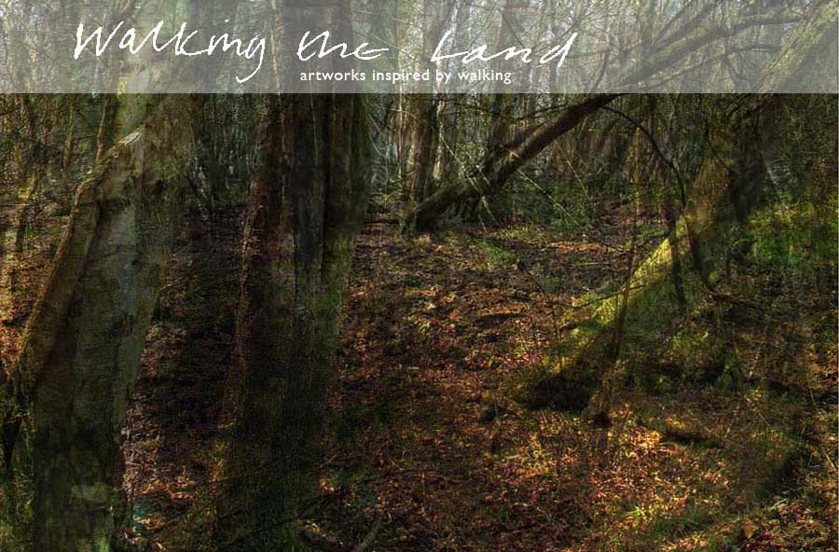
Walking the Land
A different way of looking
A different relationship
Re-embedding

Slide 20
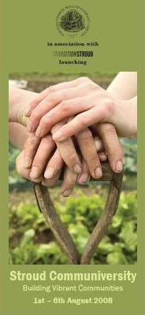
Stroud Communiversity
Projects such as Stroud Community Agriculture and Springhill Co-Housing have become inspiring ‘thought leaders'
We welcome people similarly engaged from all over the country to build a community of practice
Learning is through practical talks, discussions, workshops and visits to local projects

Slide 21
Sustainability in Practice
‘You need to imagine first and foremost what it’s like to be somewhere else in order to do the sorts of things people do there’ (Sennett: 188)
Creating opportunities for management students to learn in exemplar sustainable communities
Internalised experiential learning
Community of practice

